Slide 1
Internship Project Seminar
Summer 2025 (Session: 2024-2025)
Company:-
Babhale Infotech Solutions LLP
Title of the Project:-
“Novelnest :A smart E-Book store portal”
Presentation By :-
Guide:- Dr. Sagar Singh Rathore
Student Name | Roll No.
Niyati Borkute | 09
Pooja Badwaik | 10
Prashant Hatwar | 42
Saikiran Gannewar | 50

Slide 2
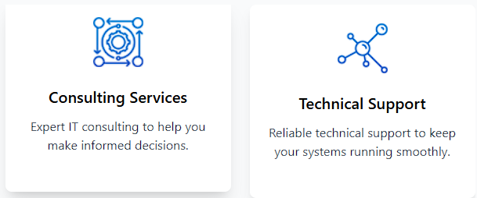
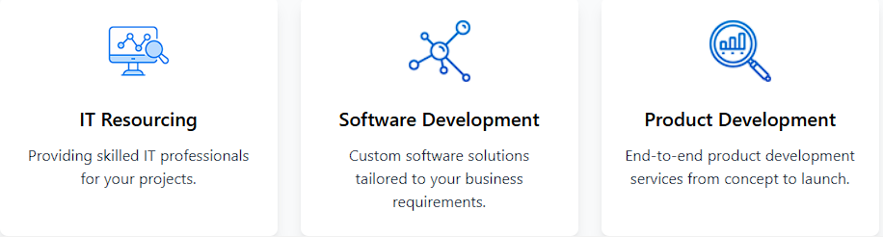
Company Overview: Babhale Infotech Solutions
Specialize in providing top-notch IT resourcing
Comprehensive IT services
Innovative product development solutions.
Company Location:1st Floor, Plot No. 10/4, STPI IT Park, Gayatri Nagar, Nagpur – 440022
Contact Info : info@babhableinfotech.com
+91-79722-69828
Company Services:

Slide 3
Project Title:- “Novelnest : A smart E-Book store portal”
Introduction:-
In today's rapidly evolving digital world, the way people read and access literature has undergone a significant transformation. Traditional bookstores and physical libraries are increasingly being supplemented—and in some cases, replaced—by digital platforms that offer greater convenience, accessibility, and personalization. In response to this shift, Novelnest: A Smart E-Book Store Portal is developed to cater to the modern reader’s needs through a powerful, intuitive, and interactive online environment.
Novelnest is more than just an online bookstore—it is a comprehensive digital platform that enables users to explore, purchase, and read e-books with ease and efficiency.
At the core of the platform lies a recommendation engine that analyzes user behavior and preferences to suggest relevant books, ensuring a tailored and engaging experience for each individual. Whether users are casual readers or avid book lovers, Novelnest helps them discover new content based on their tastes and interests.

Slide 4
Technologies Used in Smart eBook Store Portal:-
HTML5: Structures web content and supports multimedia with semantic elements.
CSS3: Styles pages using Flexbox/Grid for responsiveness and adds animations.
JavaScript (ES6+): Enables interactivity like form validation and dynamic content.
Authentication and Security: Uses JWT/OAuth with HTTPS to protect user data.
Cloud Storage: Stores eBooks and user data securely on platforms like AWS or Firebase.

Slide 5
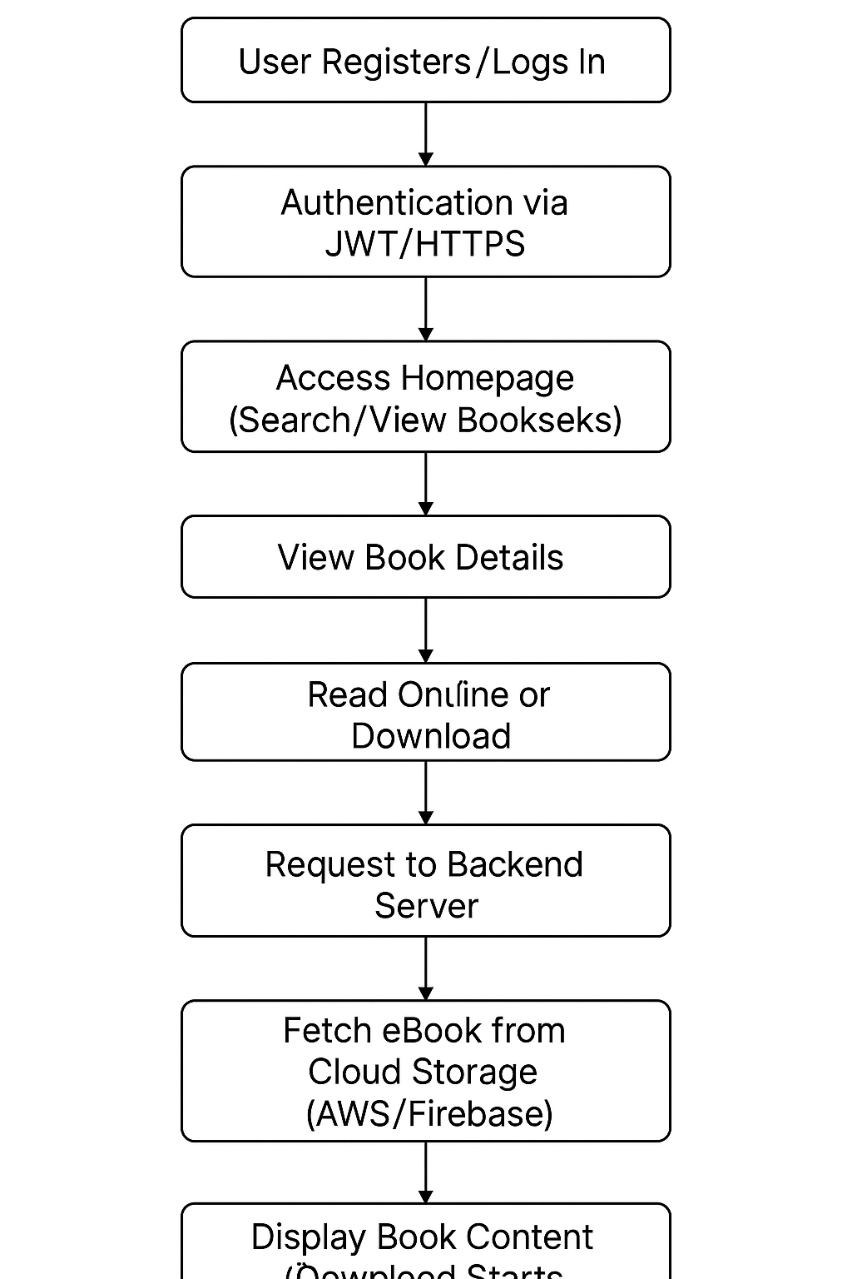
Workflow Diagram:

Slide 6
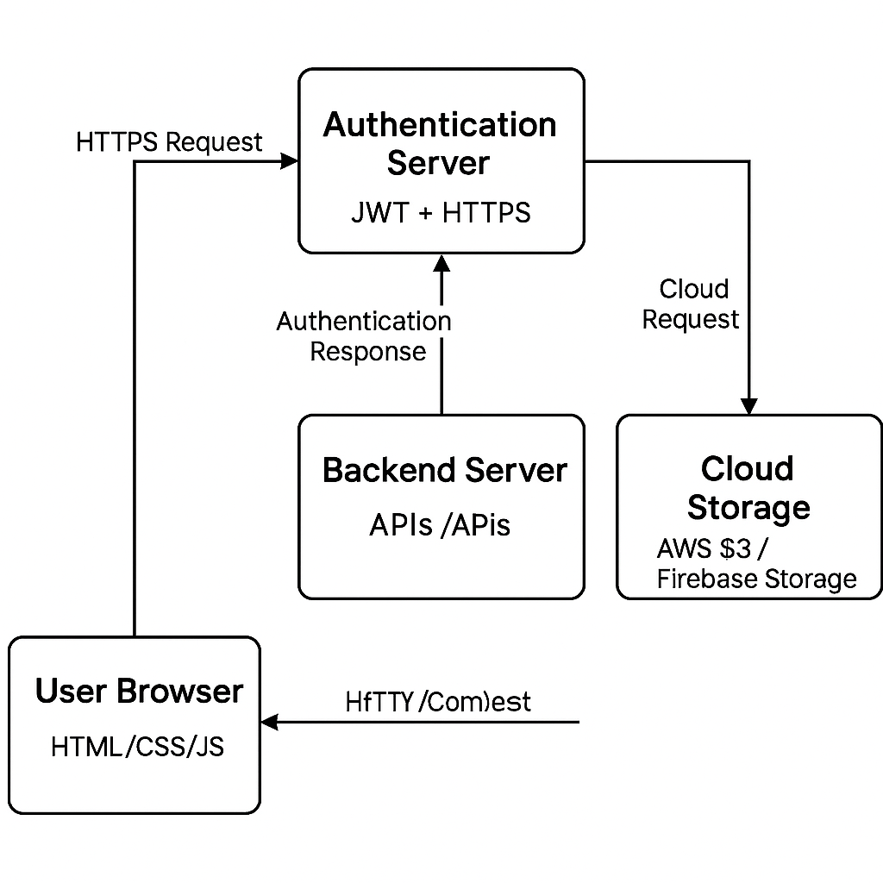
Block Diagram:
User interacts with Frontend.
Frontend sends secure requests via HTTPS.
Authentication server handles login/signup using JWT.
Backend APIs retrieve/store data in Cloud Storage.
Results (ebooks, profiles, etc.) are displayed back to the user.

Slide 7
Features of Novelnest :
User Registration and Login:
Secure sign-up and authentication system.
E-Book Search and Filters:
Search by title, author, genre, etc.
Book Previews:
Option to view sample pages before downloading or purchasing.
Download/Read Online Options:
Download e-books or read them directly online.
Responsive Design:
Works well on mobile, tablet, and desktop.
User Dashboard:
Personalized area to view downloads, purchases, and favorites.
Ratings and Reviews:
Users can rate and review e-books.
Wishlists and Favorites: Save books for future reading or buying.
Recommendation System: Suggest books based on user interest.
Multi-format Support: Support for PDF, EPUB, MOBI, etc.
Notifications: Alerts for new arrivals, offers, and updates.
Content Protection: DRM or watermarking to prevent piracy.

Slide 8
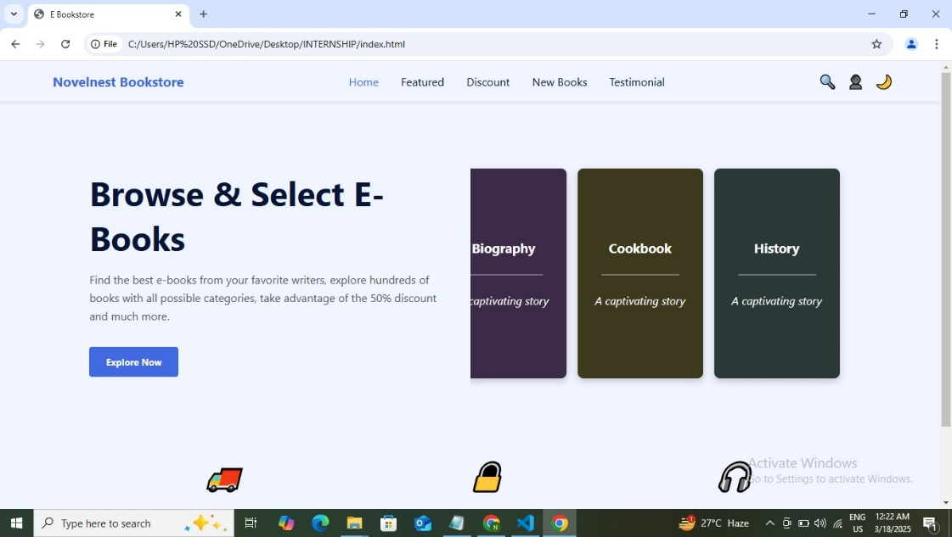
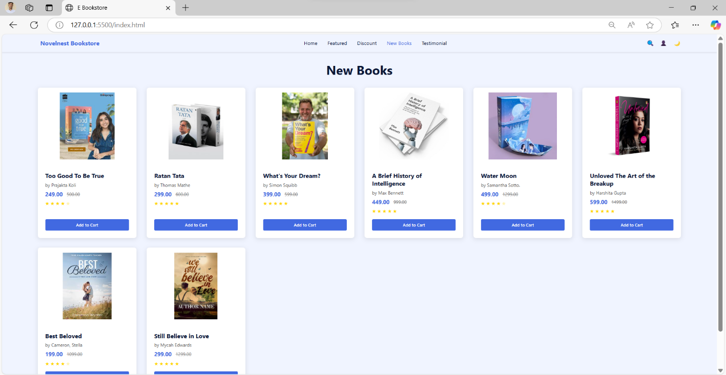
Images of Portal :

Slide 9
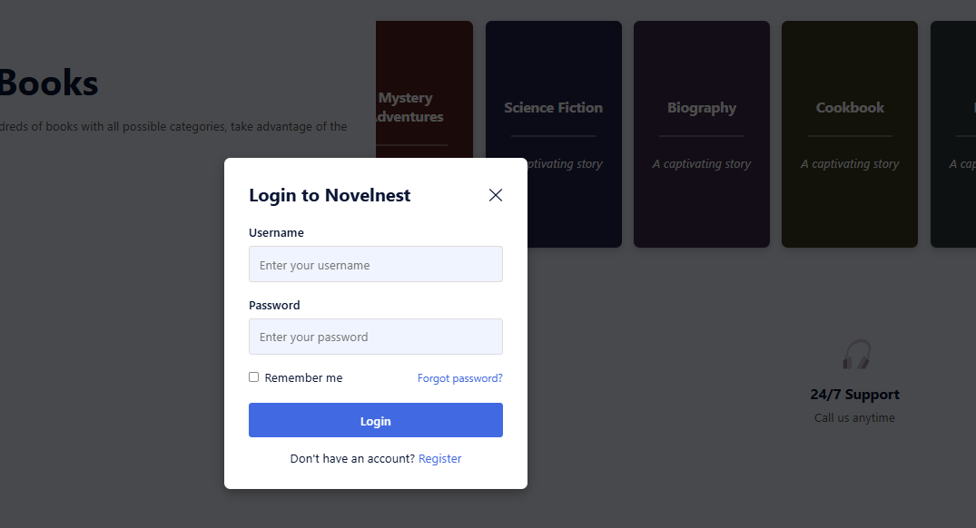
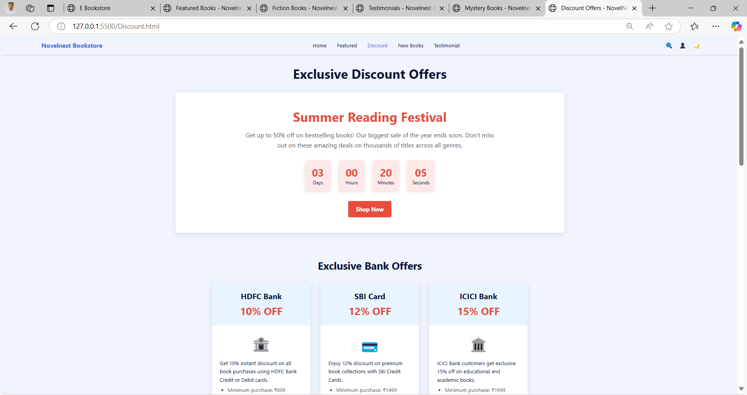

Slide 10
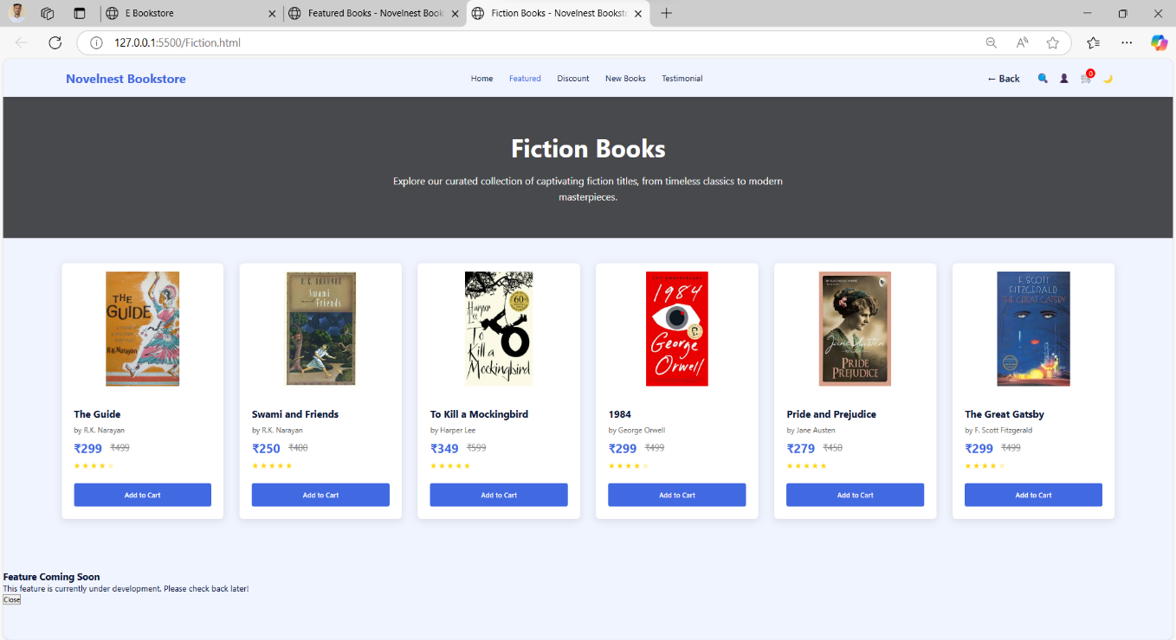
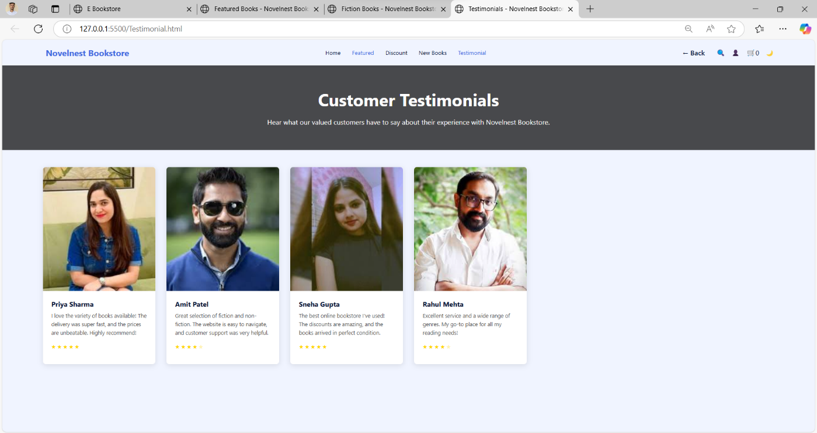

Slide 11
Advantages:
User-Friendly Interface: Clean and intuitive design makes it easy for users to browse, search, and read books.
Personalized Recommendations: Suggests books based on user interests, improving engagement and satisfaction.
Instant Search & Access: Fast search functionality allows users to find books quickly and efficiently.
Cloud-Based Digital Library: Users can save their books and access them anytime, from any device.
Bookmarking & Easy Navigation: Users can bookmark pages and resume reading from where they left off.
Responsive Design: Works seamlessly on desktops, tablets, and mobile devices.
Cost-Effective & Eco-Friendly: Reduces printing and distribution costs and supports environmental sustainability.
Wide Accessibility: Books are available 24/7 from anywhere with an internet connection.

Slide 12
Future Enhancements:
Login & User Accounts: Add secure user authentication to allow personalized profiles, bookmarks, and reading history.
Payment Gateway Integration: Enable users to purchase e-books through trusted payment options like UPI, cards, or wallets.
Admin Panel: Develop an admin dashboard for managing book listings, categories, and user activity.
Advanced Recommendation System: Use AI or machine learning to recommend books based on user interests and reading patterns.
Mobile Application: Launch a mobile app version for Android and iOS to increase accessibility and convenience.
Audiobooks & Multimedia Support: Introduce audiobook functionality and support for multimedia e-books (with audio, video, or animation).
Download & Offline Reading: Allow users to download books for offline reading without internet access.

Slide 13
Conclusion:
The Novelnest project successfully demonstrates how modern web technologies can be leveraged to create a smart, user-friendly, and engaging e-book store portal. By offering features such as personalized book recommendations, instant search, one-click purchasing, and cloud-based library access, the platform addresses the evolving needs of today’s digital readers.
With its responsive design and interactive functionalities, Novelnest enhances the overall reading experience and encourages users to explore literature in a convenient and accessible way. The project not only showcases the technical skills involved in front-end web development using HTML, CSS, and JavaScript but also emphasizes user-centric design thinking.
This project lays the groundwork for future expansion and can be further developed into a full-fledged commercial application with backend integration, AI-driven recommendation systems, and payment gateways. Overall, Novelnest represents a meaningful step toward digitizing reading habits and enriching the way people discover and engage with books.

Slide 14
Thank You

